Slide 1
Data Structure and Algorithms
Chetan Gupta

Slide 2
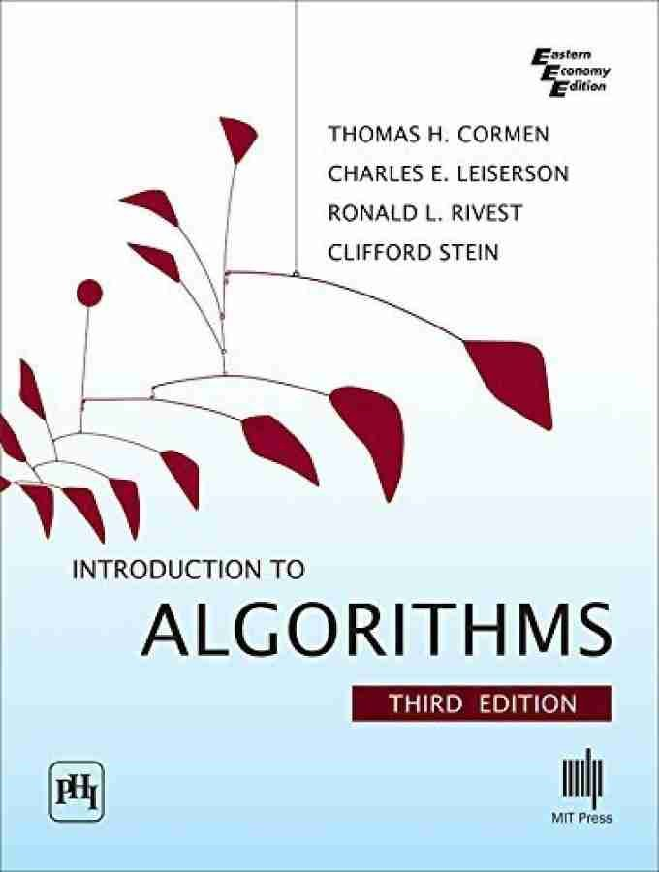
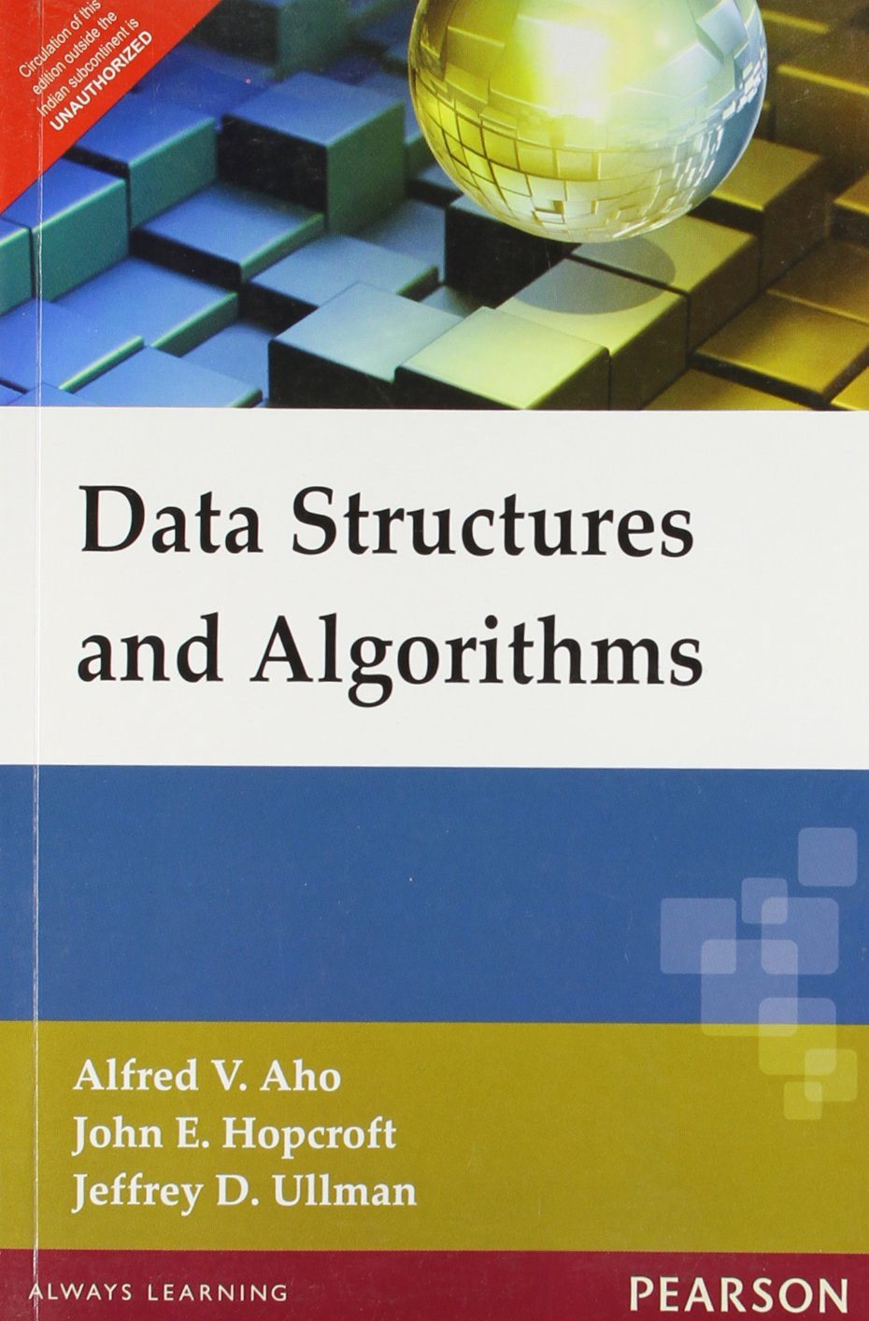
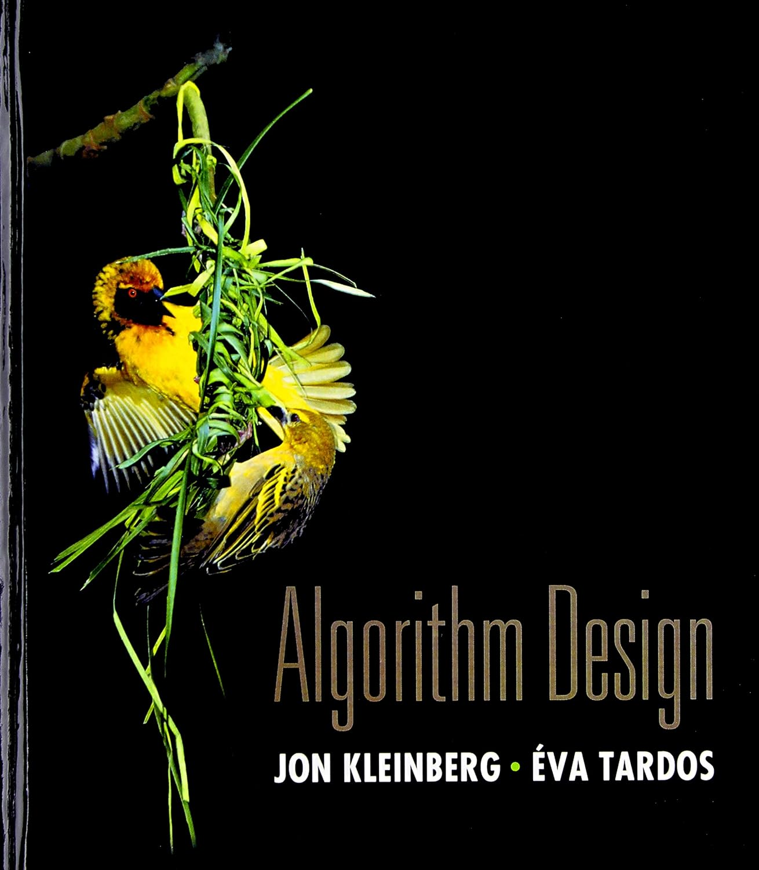
Study Material
Slides by the instructor
Books:

Slide 3
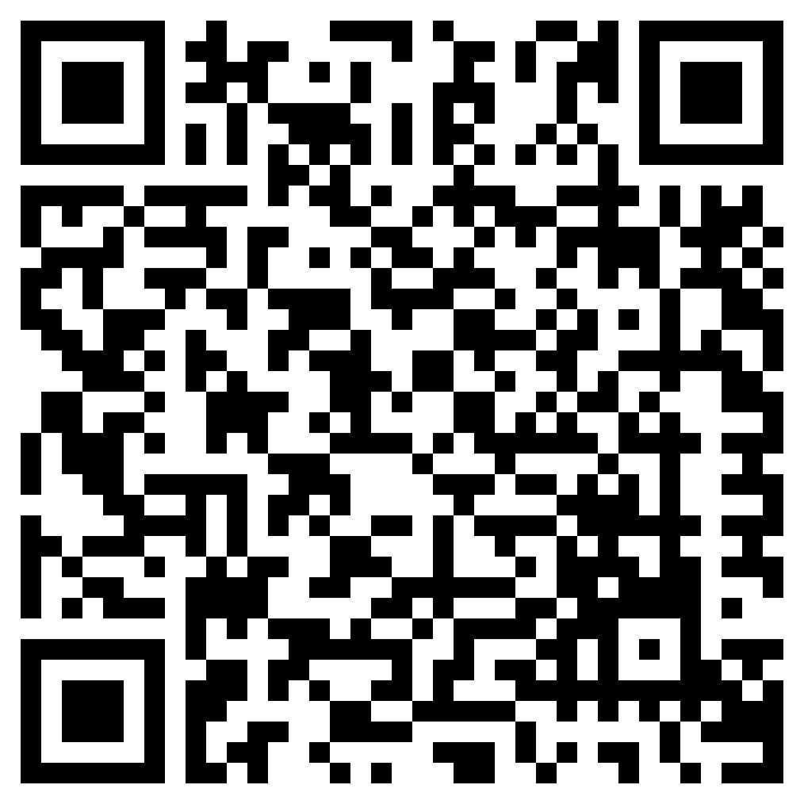
Study Material
You may also refer to youtube lectures: Design and Analysis of Algorithms by Tim Roughgarden

Slide 4
Evaluation
Midterm exam : 25%
Endterm exam : 50%
Quizzes [2-4] : 25%
Any form cheating or use of unfair means will be penalised

Slide 5
Module 1
Complexity Analysis-Notations

Slide 6
Data Structure
Store, organize, and manipulate data efficiently.
Example: Suppose, we want to maintain names of all the students attending this course, in alphabetical order.
Updates: A new student can join the course at any point of time and an existing student can leave the course at any point of time.
How should we store this data so that we can perform these updates efficiently (fast)?

Slide 7
Data Structure
One way:
Aarav
Aishwarya
Dhruv
Isha
Jai
Kavya
Meera
-
-
-
-
-

Slide 8
Algorithms
A step-by step procedure to solve a problem
Input /Problem
Output
/Solution

Slide 9
Example: Search Problem
Given an array of strings:
and a number string (name) x, answer whether the name exists in the array.
Aarav | Aishwarya | Dhruv | Isha | Jai | Kavya | Meera | Rohan | Tanvi

Slide 10
Algorithm
Start from the first element in the array
Repeat step 3-5, until the end of the array.
Compare the current name with x
If the current name is same as x, output yes and stop
If the current name is not same as x, goto the next element in the array
Output no, and stop
Aarav | Aishwarya | Dhruv | Isha | Jai | Kavya | Meera | Rohan | Tanvi

Slide 11
Algorithms
How to measure the performance of an algorithms? (i.e. the running time of an algorithm)
How do we compare two algorithms?

Slide 12

Asymptotic Notation
Performance of an algorithm is often described as a function, say$,$ $f(n)$ where $n$ denotes the size of the input problem
Start from the first element in the array
Repeat step 3 and 4, until the end of the array.
Compare the current name with x. If the current name is same as x, output yes and stop
If the current name is not same as x, goto the next element in the array
Output no, and stop
Aarav | Aishwarya | Dhruv | Isha | Jai | Kavya | Meera | Rohan | Tanvi

Slide 13
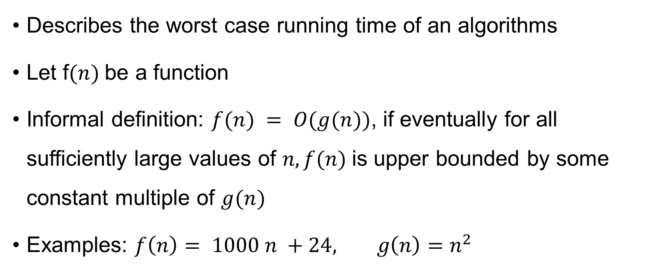

Big O ($O$)
Describes the worst case running time of an algorithms
Let f$(n)$be a function
Informal definition: $f(n) = O(g(n))$, if eventually for all sufficiently large values of $n, f(n)$is upper bounded by some constant multiple of $g(n)$
Examples: $f\left(n\right)= 1000 n +24, g\left(n\right)=n^{2}$

Slide 14
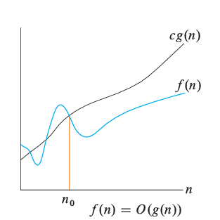
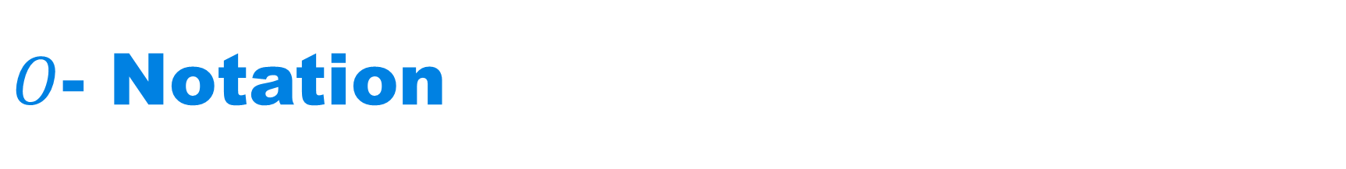

$O$- Notation
$f\left(n\right) = O\left(g\left(n\right)\right),$if there exist positive constants $c$ and $n_{0}$ such that $0≤f\left(n\right)≤cg\left(n\right),$ for all $n≥ n_{0}$
The picture has been taken from book “Introduction to Algorithms” by Cormen et al.

Slide 15

Examples
$f\left(n\right)=2n^{3}$

Slide 16

Examples
$f\left(n\right)=2n^{2}+3n+1$

Slide 17

Examples
$f\left(n\right)=3n^{2}\log{n }$

Slide 18

Examples
$f\left(n\right)=n/2$

Slide 19

Examples
$f\left(n\right)=25$

Slide 20
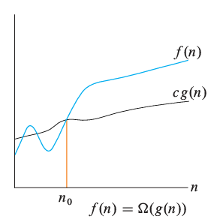

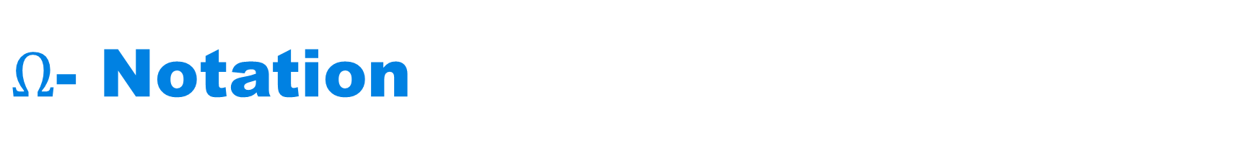
$Ω$- Notation
$f\left(n\right) = Ω\left(g\left(n\right)\right),$if there exist positive constants $c$ and $n_{0}$ such that $0≤cg\left(n\right)≤f\left(n\right)$, for all $n≥ n_{0}\}$
The picture has been taken from book “Introduction to Algorithms” by Cormen et al.

Slide 21
Examples
$f\left(n\right)=2n^{3}$

Slide 22
Examples
$f\left(n\right)=2n^{2}+3n+1$

Slide 23
Examples
$f\left(n\right)=3n^{2}\log{n }$

Slide 24
Examples
$f\left(n\right)=n/2$

Slide 25
Examples
$f\left(n\right)=25$

Slide 26
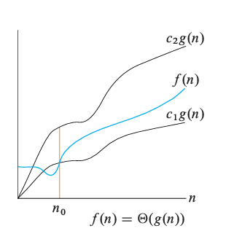

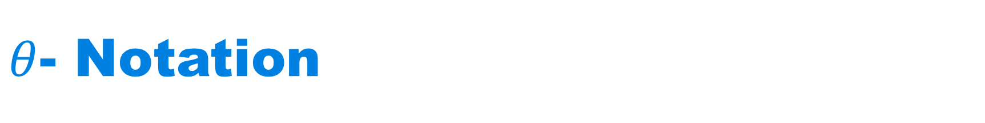
$θ$- Notation
$f\left(n\right) = Θ\left(g\left(n\right)\right),$if there exist positive constants $c_{1}, c_{2}$ and $n_{0}$ such that $0≤c_{1}g\left(n\right)≤f\left(n\right) {≤c}_{2}g\left(n\right),$for all $n≥ n_{0}\}$
The picture has been taken from book “Introduction to Algorithms” by Cormen et al.

Slide 27
Examples
$f\left(n\right)=2n^{3}$

Slide 28
Examples
$f\left(n\right)=2n^{2}+3n+1$

Slide 29
Examples
$f\left(n\right)=3n^{2}\log{n }$

Slide 30
Examples
$f\left(n\right)=n/2$

Slide 31
Examples
$f\left(n\right)=25$

Slide 32

Examples
$f\left(n\right)=\log{n}$
$f\left(n\right)=n^{0.1}$

Slide 33

Examples
$f\left(n\right)=2^{n}$
$f\left(n\right)=n^{n}$

